Slide 1
Unit-2: Modulation and Switching Techniques

Slide 2
Unit-2: Modulation and Switching
Analog Transmission: Modulation of Digital Data, Modulation of Analog signals. Multiplexing: FDM, WDM, TDM, Transmission Media: Guided Media, Unguided Media, Circuit Switching and Packet Switching.

Slide 3
Analog Transmission

Slide 4
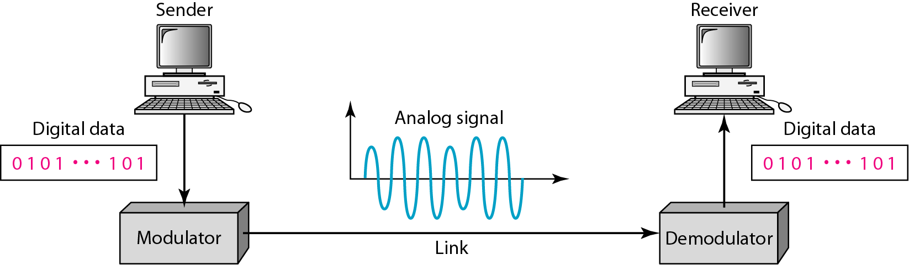
Digital to Analog Conversion
Digital-to-analog conversion is the process of changing one of the characteristics of an analog signal based on the information in digital data.
Digital data needs to be carried on an analog signal.
A carrier signal (frequency fc) performs the function of transporting the digital data in an analog waveform.

Slide 5
Types of digital-to-analog conversion

Slide 6

Note
Bit rate, N, is the number of bits per second (bps).
Baud rate is the number of signal elements per second (bauds).
In the analog transmission of digital data, the signal or baud rate is less than or equal to the bit rate.
S=Nx1/r bauds
r is the number of data bits per signal element.

Slide 7
Q1. An analog signal carries 4 bits per signal element. If 1000 signal elements are sent per second. Find the bit rate.
Solution: In this case, r =4, S=1000
S= N ×1/r
Hence, N=S × r =1000 × 4 =4000bps

Slide 8
Amplitude Shift Keying (ASK)
The general expression of an electrical signal is given by
C(t) =A cos (2πf_{c}t + φ)
A= Amplitude
f_{c} = Frequency
Φ= Phase angle
In ASK, the amplitude of the carrier signal is varied to create signal elements. Where as both frequency and phase remain constant.

Slide 9
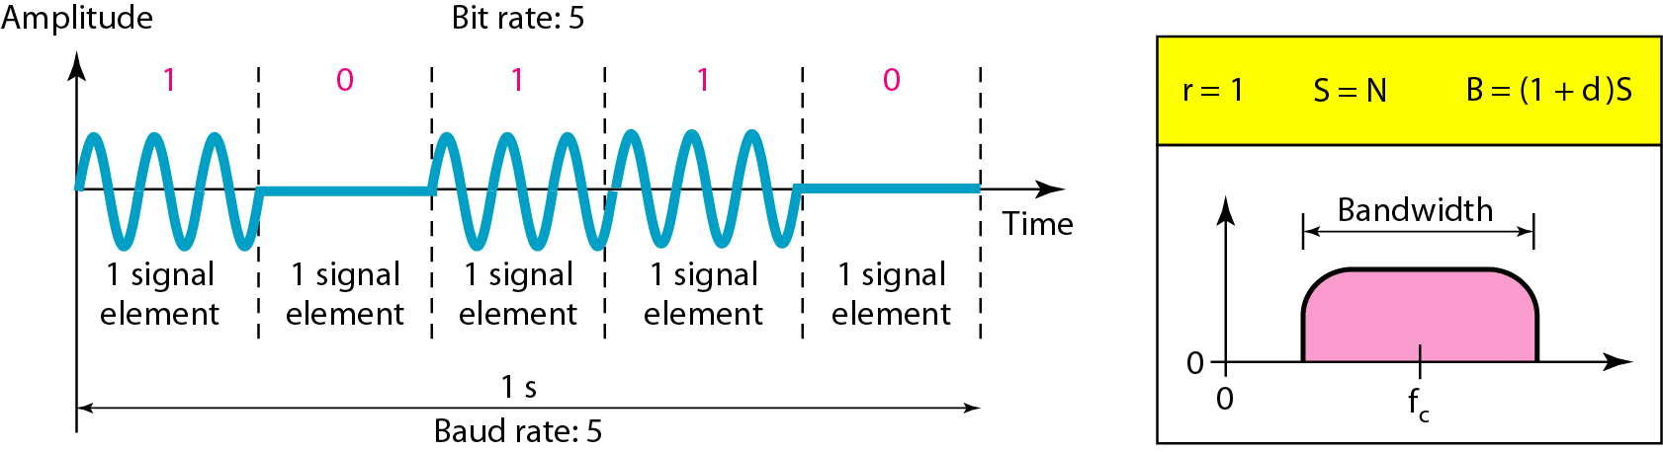
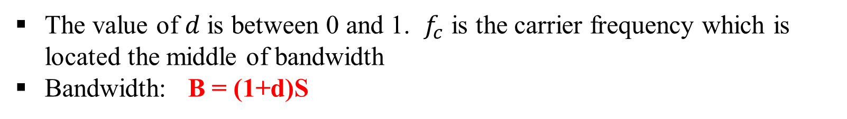
Binary ASK
ASK is implemented by changing the amplitude of a carrier signal to reflect amplitude levels in the digital signal.
a digital “1” could not affect the signal, whereas a digital “0” would, by making it zero.
The value of $d$ is between 0 and 1. $f_{c}$ is the carrier frequency which is located the middle of bandwidth
Bandwidth: B = (1+d)S

Slide 10
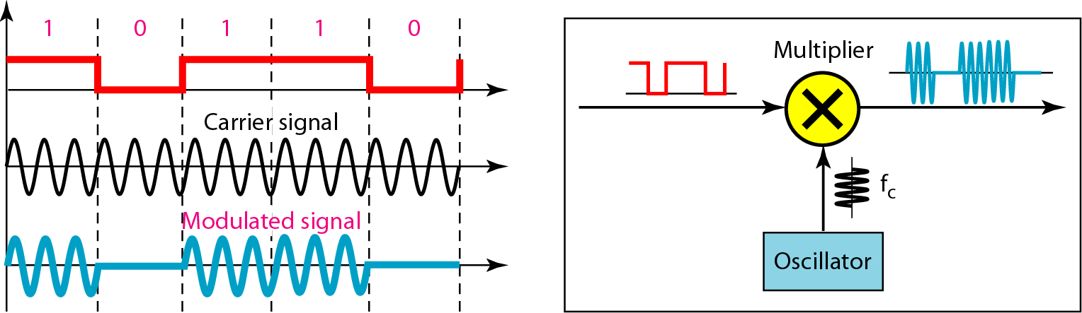
Binary ASK
The line encoding will determine the values of the analog waveform to reflect the digital data being carried.
BASK modulated signal is generated by multiplying unipolar NRZ with carrier signal.

Slide 11
We have an available bandwidth of 100 kHz which spans from 200 to 300 kHz. What are the carrier frequency and the bit rate if we modulated our data by using ASK with d = 1?
Solution
The middle of the bandwidth is located at 250 kHz. This means that our carrier frequency can be at f_{c} = 250 kHz. We can use the formula for bandwidth to find the bit rate (with d = 1 and r = 1).

Slide 12
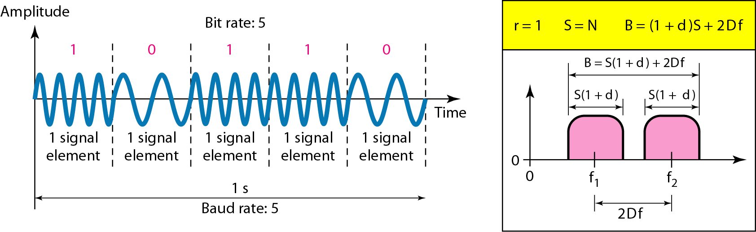
Frequency Shift Keying (FSK)
In FSK, the frequency of the carrier signal is varied to represent data.
For example, a “1” could be represented by f₁=f_{c} +Δf, and a “0” could be represented by f₂=f_{c}-Δf.

Slide 13
Implementation of BFSK
BFSK can be implemented using NRZ and VCO
A VCO is an oscillator whose output frequency depends on an input control voltage.

Slide 14
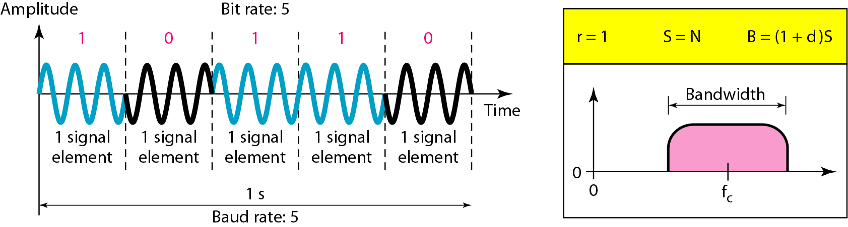
Phase Shift Keying (PSK)
In PSK, the phase of the carrier is varied to represent two or more different signal elements.
Noise can change the amplitude easier than it can change phase.
PSK is superior to FSK because we do not need two carrier signals.
PSK needs more sophisticated hardware compared to FSK to be able to distinguish between phases.

Slide 15
Binary Phase Shift Keying (BPSK)
BPSK modulated signal is generated by multiplying Polar NRZ with carrier signal.
Figure: Implementation of BPSK

Slide 16
Analog to Analog Conversion
Analog-to-analog conversion or analog modulation is the representation of analog information by an analog signal.
One may ask why we need to modulate an analog signal; it is already analog.
Modulation is needed if the medium is bandpass in nature or if only a bandpass channel is available to us.

Slide 17
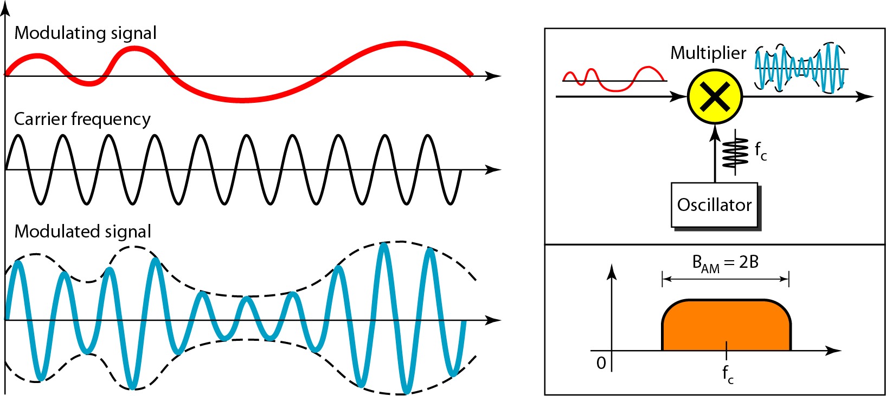
Amplitude Modulation (AM)
In AM transmission, the amplitude of the carrier signal varies with the changing amplitudes of the modulating signal.
The modulating signal is the envelope of the carrier.
The required bandwidth is 2B, where B is the bandwidth of the modulating signal.

Slide 18
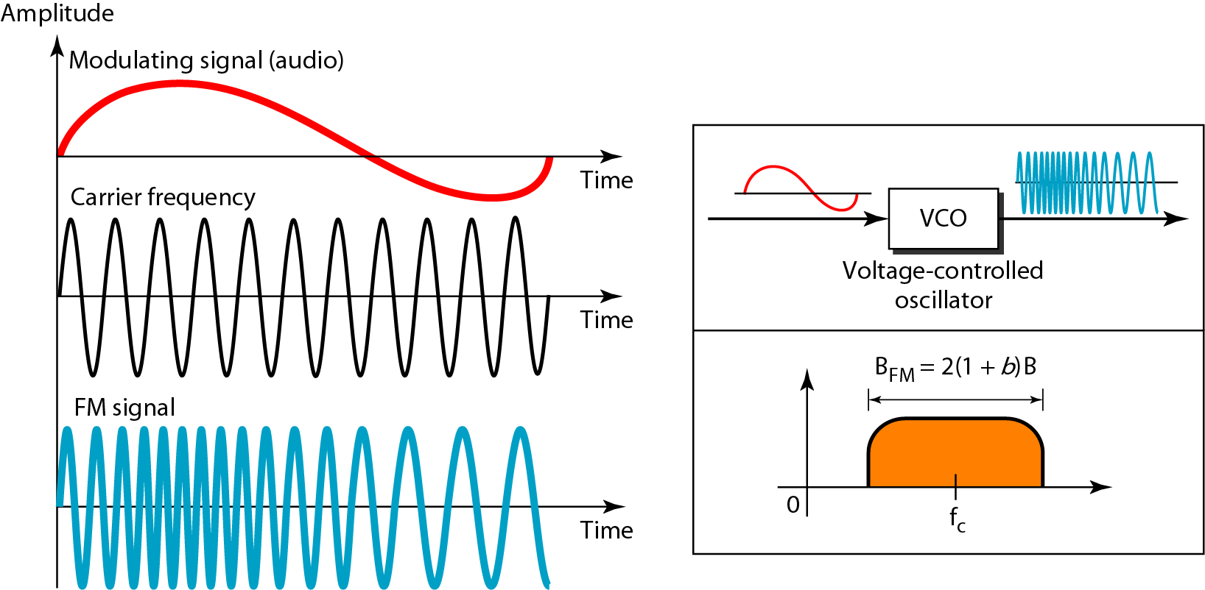
Frequency Modulation (FM)
The modulating signal changes the frequency (fc) of the carrier signal.
The frequency of the oscillator changes according to the input voltage.

Slide 19
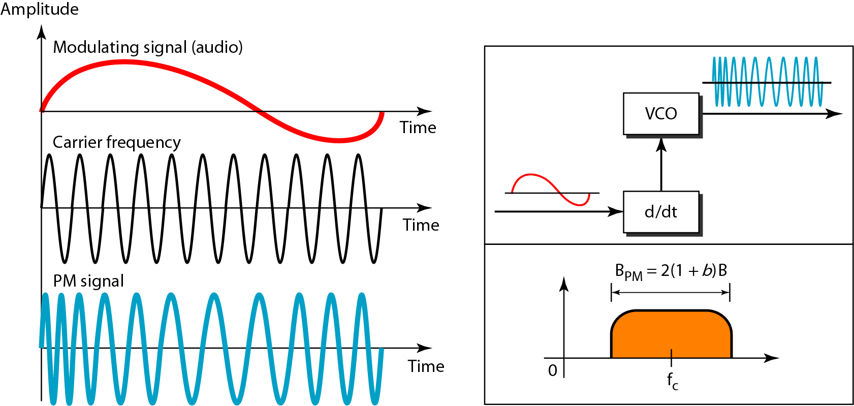
Phase Modulation (PM)
The modulating signal only changes the phase of the carrier signal.
The phase change manifests itself as a frequency change but the instantaneous frequency change is proportional to the derivative of the amplitude.

Slide 20
MULTIPLEXING

Slide 21
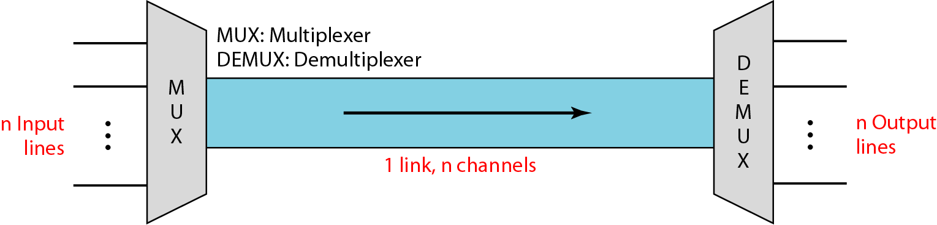
MULTIPLEXING
Multiplexing is a technique that allow the simultaneous transmission of multiple signals across a single data link.
Multiplexer (MUX), combines n streams of data into a single stream (many-to-one).
Demultiplexer (DEMUX), which separates the stream back into its component transmissions (one-to-many) and directs them to their corresponding lines.

Slide 22
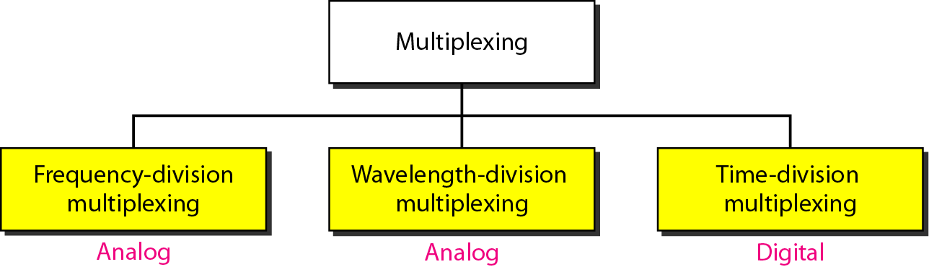
TYPES OF MULTIPLEXING

Slide 23
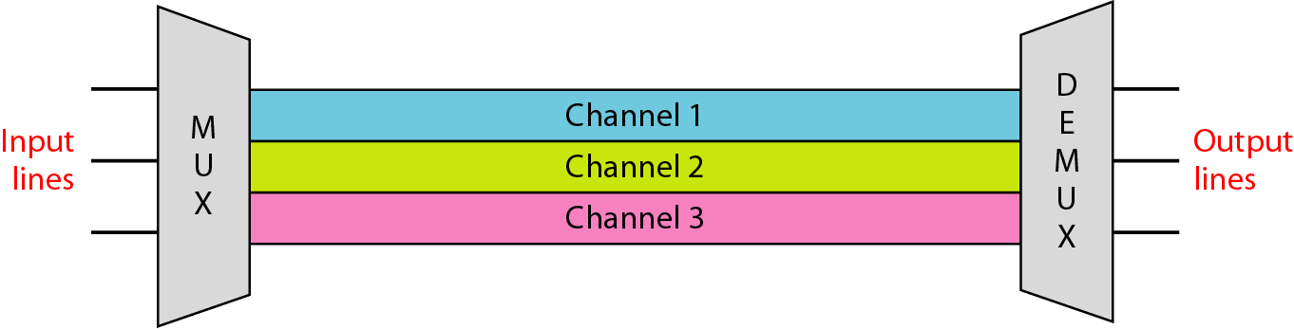
FREQUENCY DIVISION MULTIPLEXING (FDM)
FDM is an analog multiplexing technique that combines analog signals.
A digital signal can be converted to an analog signal before FDM is used to multiplex them.
Guard bands: to separate signals of different carrier frequencies.
Use: Telephone lines, FM, AM.

Slide 24
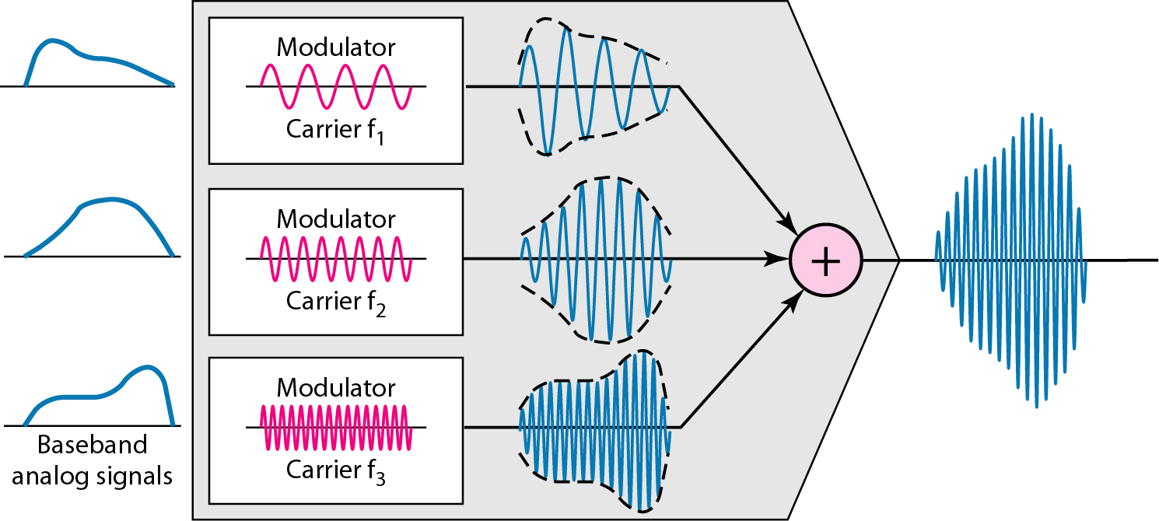
FDM process

Slide 25
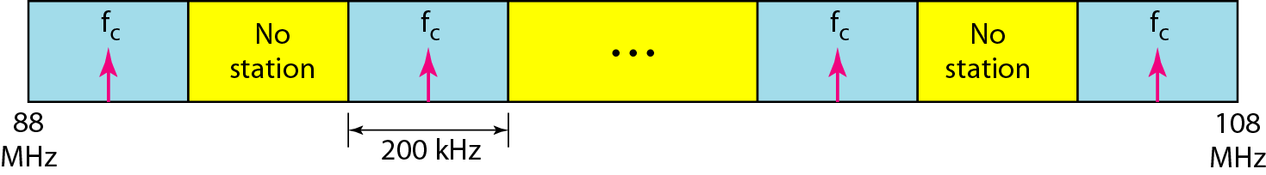
Frequency Modulation

Slide 26
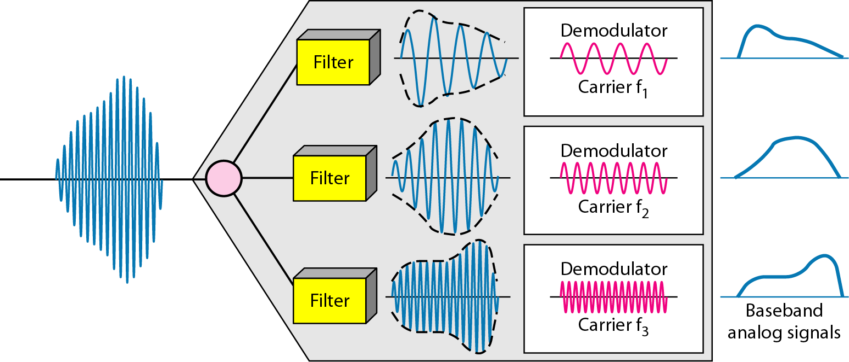
FDM demultiplexing example

Slide 27
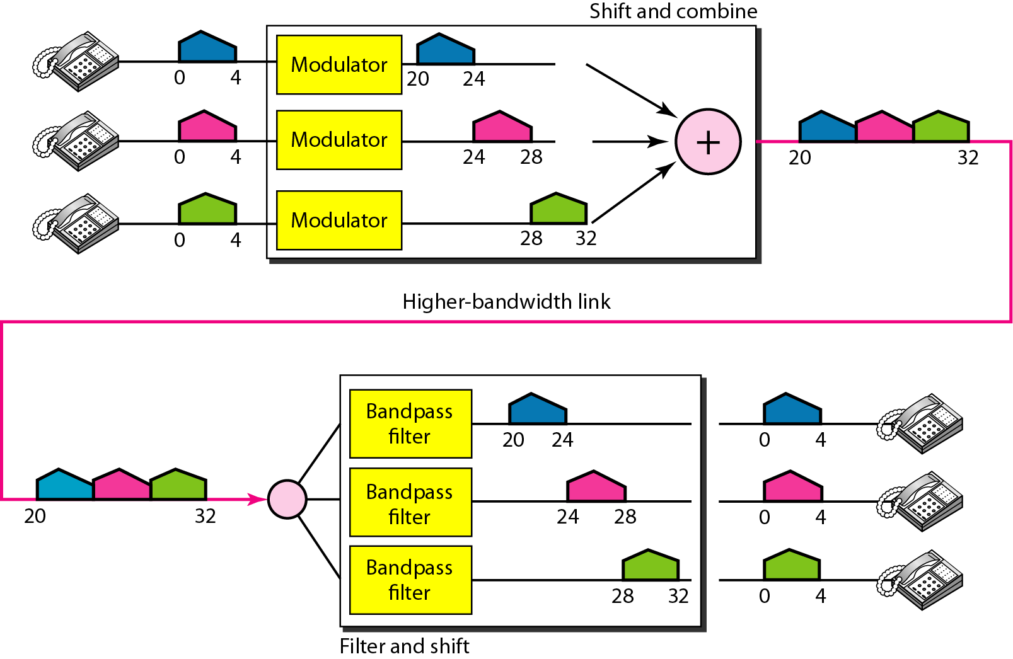
FREQUENCY DIVISION MULTIPLEXING (FDM)
Assume that a voice channel occupies a bandwidth of 4 kHz. We need to combine three voice channels into a link with a bandwidth of 12 kHz, from 20 to 32 kHz. Show the configuration, using the frequency domain. Assume there are no guard bands.

Slide 28
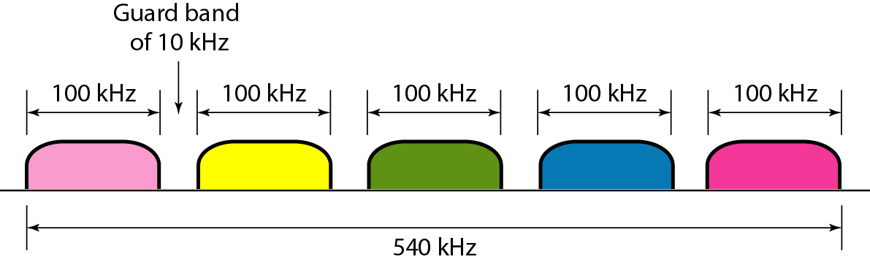
Five channels, each with a 100-kHz bandwidth, are to be multiplexed together. What is the minimum bandwidth of the link if there is a need for a guard band of 10 kHz between the channels to prevent interference?
Solution
For five channels, we need at least four guard bands. This means that the required bandwidth is at least
5 × 100 + 4 × 10 = 540 kHz,
as shown in Figure

Slide 29
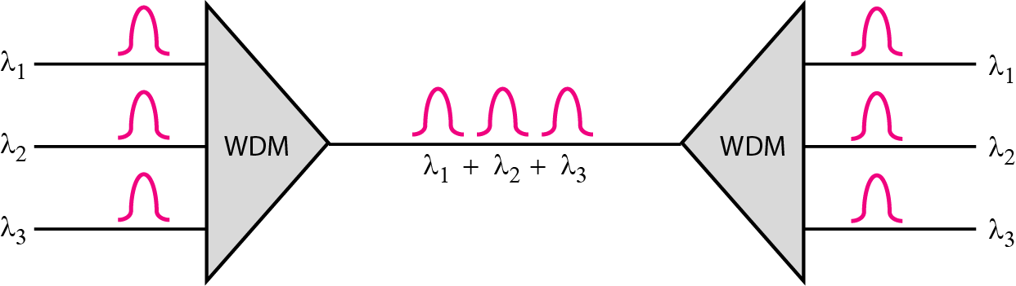
WAVELENGTH DIVISION MULTIPLEXING (WDM)
This is an analog multiplexing technique to combine optical signals.

Slide 30
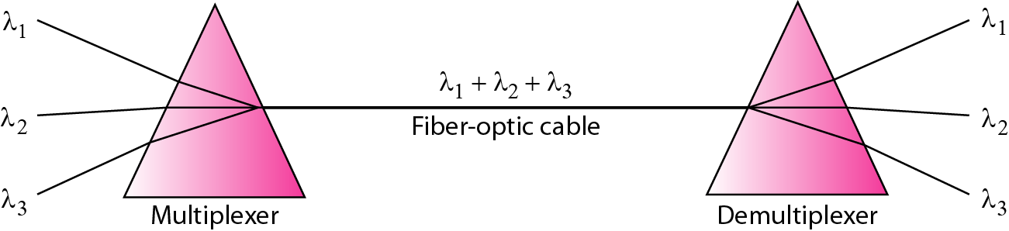
Prisms in wavelength-division multiplexing and demultiplexing

Slide 31
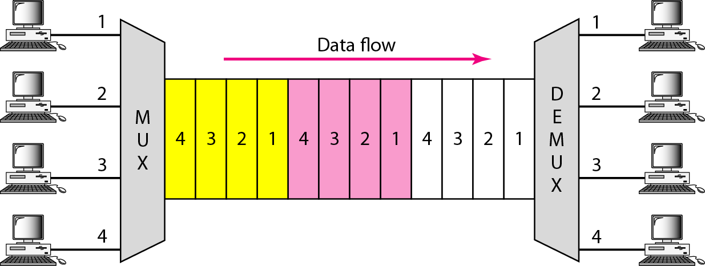
TIME DIVISION MULTIPLEXING (TDM)
Instead of sharing a portion of the bandwidth as in FDM, time is shared.
Analog data can be changed to digital data, and then multiplexed by using TDM.
TDM is a digital multiplexing technique for combining several low-rate channels into one high-rate one.

Slide 32
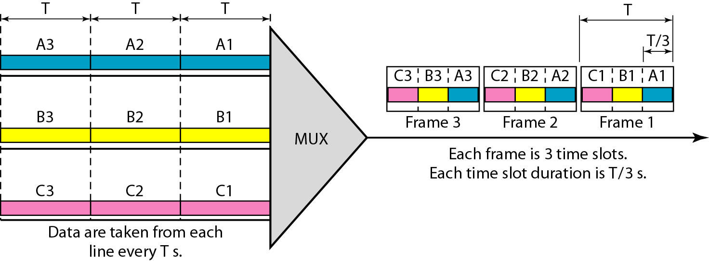
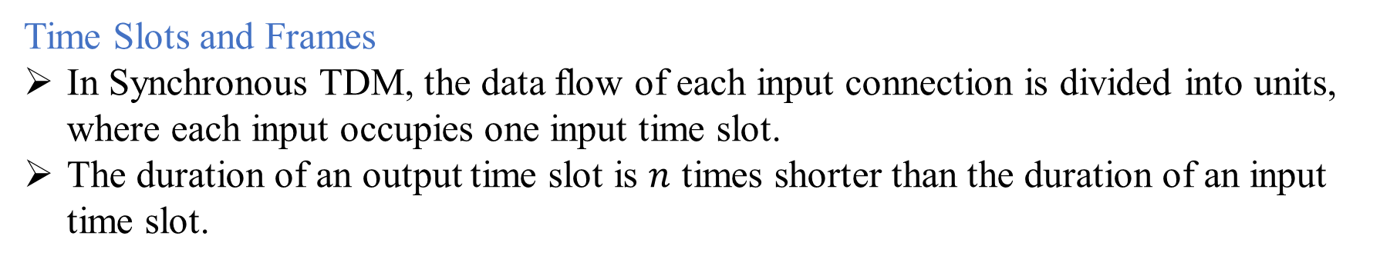
TIME DIVISION MULTIPLEXING (TDM)
Time Slots and Frames
In Synchronous TDM, the data flow of each input connection is divided into units, where each input occupies one input time slot.
The duration of an output time slot is $n$ times shorter than the duration of an input time slot.

Slide 33
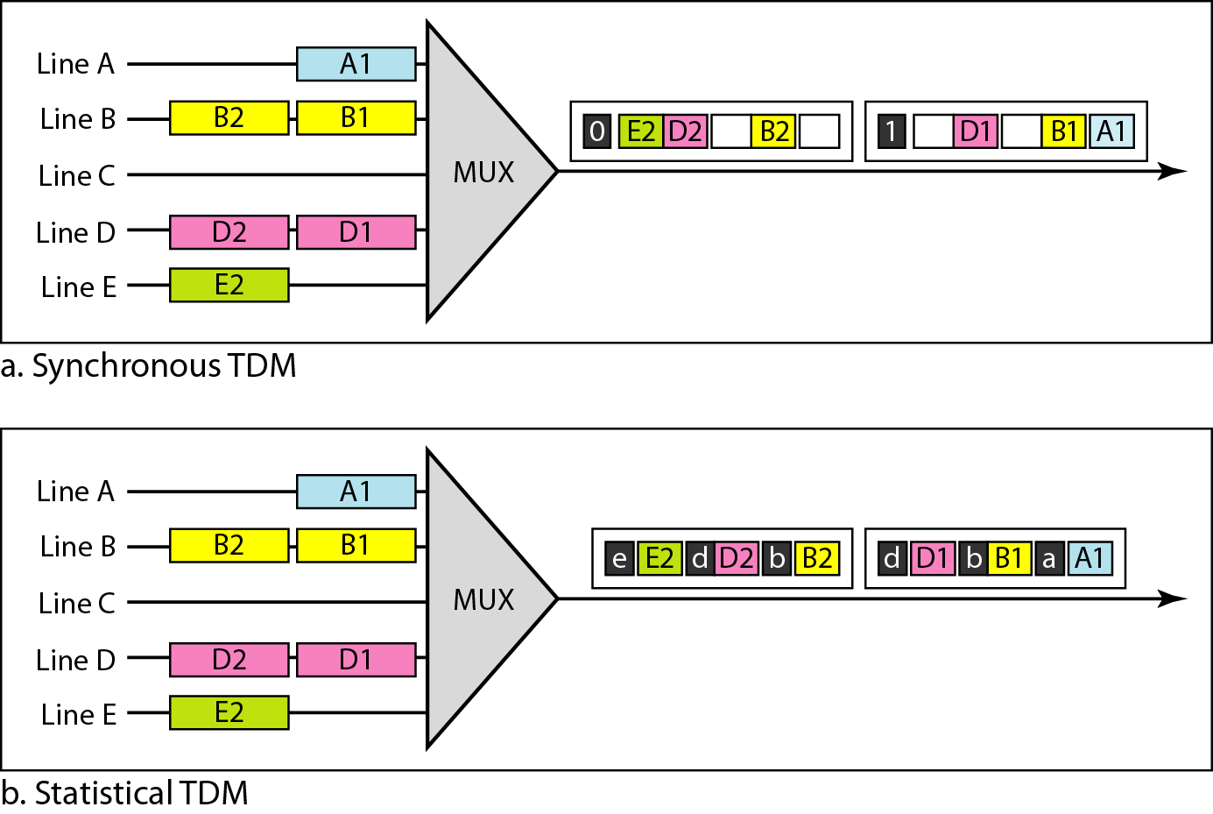
TDM slot comparison
The asynchronous time division multiplexing, which is also called statistical TDM, allocates the time slots dynamically to the data streams based on requirements.
In such types of multiplexing, the time slot is assigned only when the data stream has some information to be sent, making it more flexible.

Slide 34
Feature | Synchronous TDM | Asynchronous TDM (Statistical TDM)
Time Slot Allocation | Fixed time slots pre-assigned to each data stream | Time slots are dynamically assigned based on demand
Bandwidth Utilization | Inefficient; unused slots lead to bandwidth wastage | Efficient; slots are only used when data is present
Data Transmission | Consistent, regardless of whether data is available | Transmits only when data is ready to be sent
Suitability | Ideal for continuous, predictable data streams | Suitable for bursty or irregular data transmission
Latency | Predictable latency due to fixed slots | Latency may vary based on demand and slot availability
Complexity | Simpler to implement with pre-determined slots | More complex due to dynamic slot assignment
Synchronization | Easier to synchronize due to fixed time slots | Harder to synchronize with dynamic allocation
Cost Efficiency | Less cost-efficient due to potential unused slots | More cost-efficient, as resources are allocated on demand

Slide 35
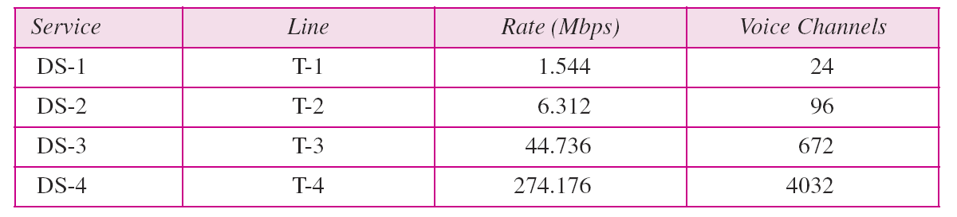
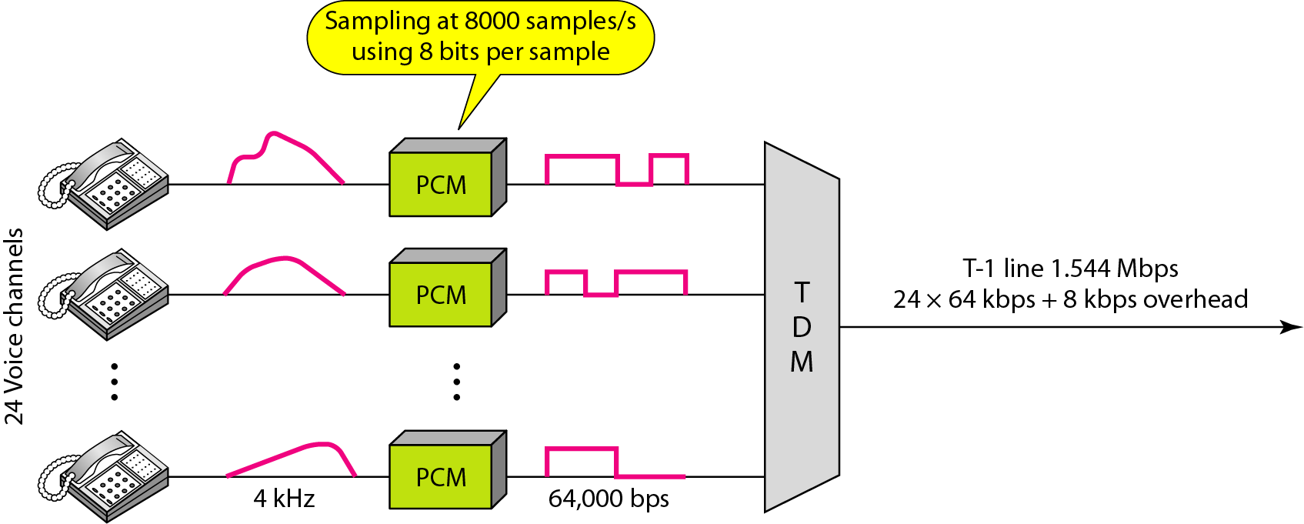
Table DS and T line rates

Slide 36
TRANSMISSION MEDIA

Slide 37
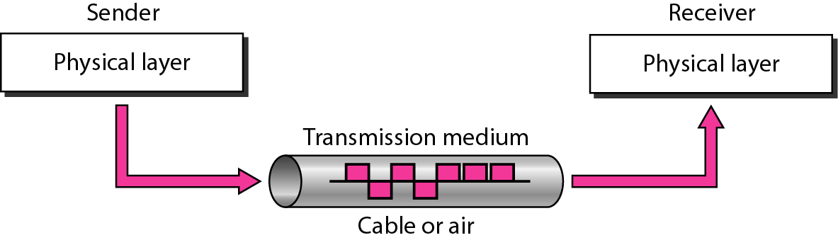
Transmission Medium
A transmission medium can be broadly defined as anything that can carry information from a source to a destination.
The transmission medium is usually free space, metallic cable, or fiber-optic cable.

Slide 38
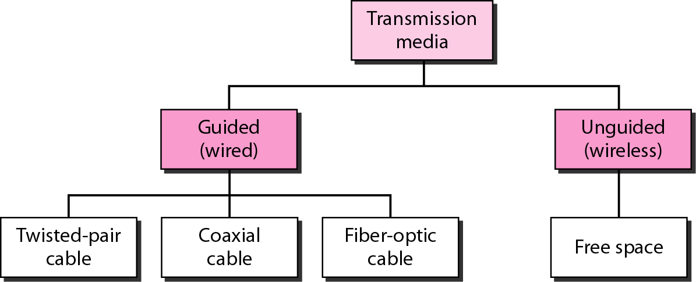
Types of Transmission Medium

Slide 39
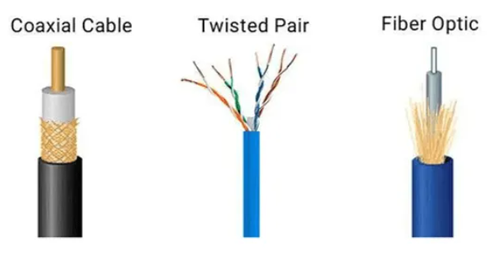
Guided Media
Guided media, which are those that provide a conduit from one device to another, include twisted-pair cable, coaxial cable, and fiber-optic cable.
Types of Guided Media
Twisted-Pair Cable
Coaxial Cable
Fiber-Optic Cable

Slide 40
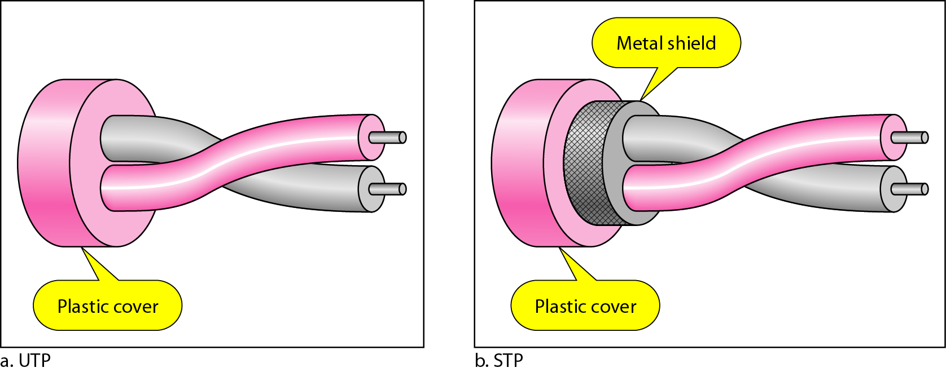
Twisted-Pair Cable
Twisted Pair Cable : Wires are twisted together in pairs. Each pair would consist of a wire used for the positive data signal and a wire used for the negative data signal.
Consists of pairs of insulated copper wires twisted around each other.
  Unshielded Twisted Pair (UTP): Cables without shields
  Shielded Twisted Pair (STP): Cables with shields

Slide 41
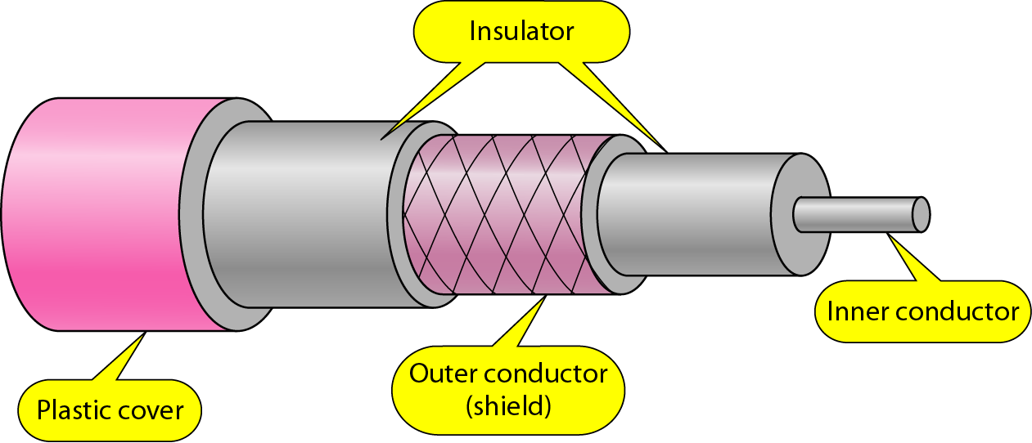
Coaxial Cable
It consists of two conductors. The inner conductor of the coaxial cable is contained inside the insulator with the other conductor weaves around it providing a shield.
Consists of copper core conductor, dielectric insulator, metallic shield, and outer cover.
Provides better shielding than twisted pair, hence higher bandwidth.
Applications: Cable TV, broadband Internet, early computer networks.

Slide 42
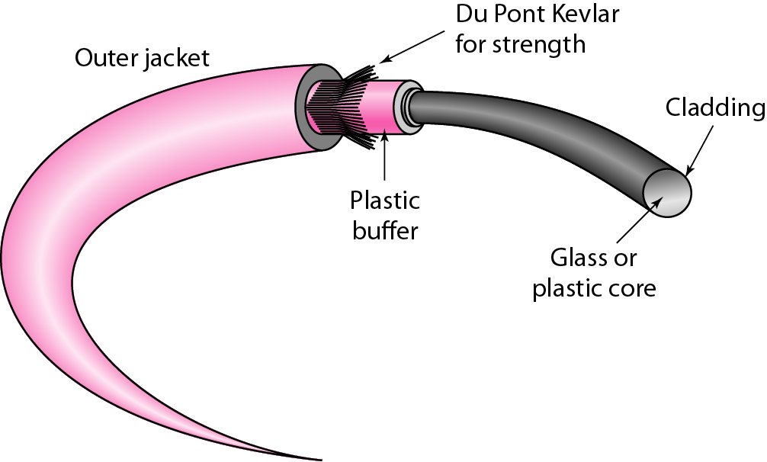
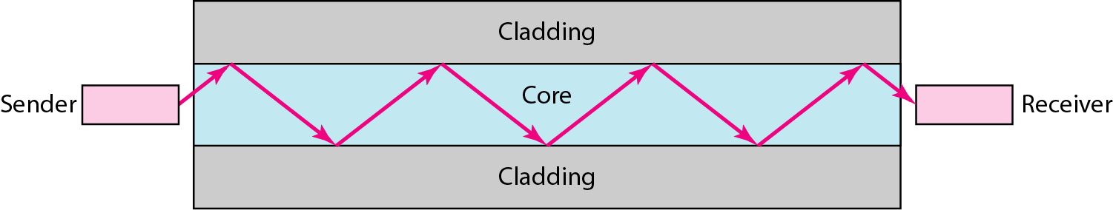
Fiber-Optic Cable
Made of thin strands of glass or plastic that transmit data using light signals.
Uses total internal reflection to confine light inside the core.
Advantages:
Very high bandwidth (Tbps range).
Immune to electromagnetic interference.
Long-distance communication with low attenuation.
total internal reflection

Slide 43
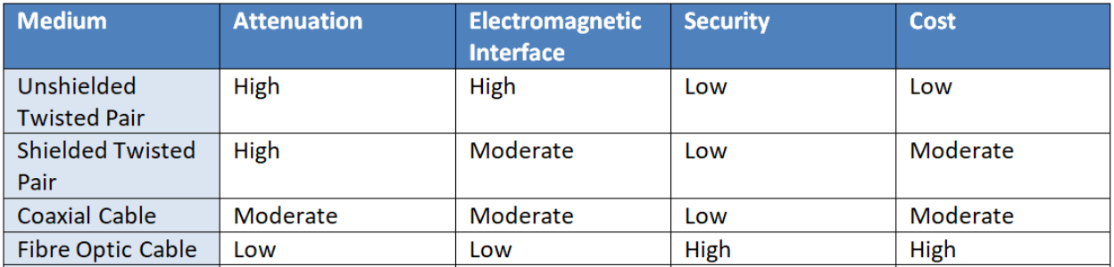
Guided Meida Comparison Table

Slide 44
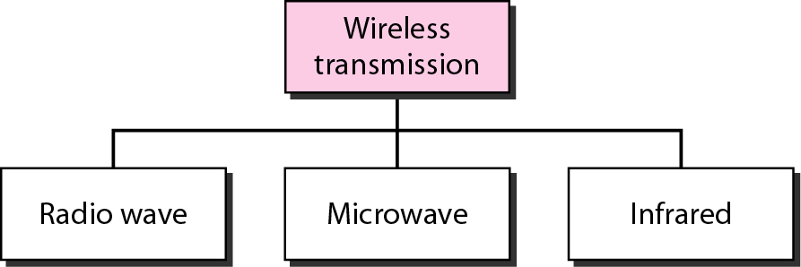
Unguided Media
Unguided media transport electromagnetic waves without using a physical conductor. This type of communication is often referred to as wireless communication.

Slide 45
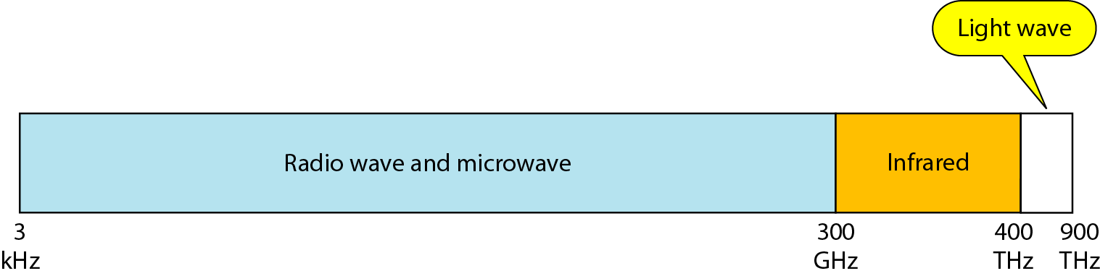
Wireless Communication
Radio Waves: Radio waves are used for multicast communications, such as radio and television, and paging systems.
They can penetrate through walls. Use omni directional antennas.
Microwaves: Microwaves are used for unicast communication such as cellular telephones, satellite networks, and wireless LANs.
Higher frequency ranges cannot penetrate walls. Use directional antennas - point to point line of sight communications.
Infrared: Infrared signals can be used for short-range communication in a closed area using line-of-sight propagation.

Slide 46
SWITCHING

Slide 47
Switched Networks
Switches are devices capable of creating temporary connections between two or more devices linked to the switch.
In a switched network, some of these nodes are connected to the end systems. Others are used only for routing.
Example- Computers or telephones etc.

Slide 48
Classification of switched Networks
A circuit-switched network is implemented in the physical layer, a datagram network in the network layer and a virtual-circuit network is implemented in the data link layer.

Slide 49
CIRCUIT-SWITCHED NETWROKS
A circuit-switched network consists of a set of switches connected by physical links.
Circuit switching takes place at the physical layer.
Each link is divided into n channels by using FDM or TDM.
Data transferred between the two stations are “not packetized” (“continuous flow”)
Before starting communication, the stations must make a reservation for the resources to be used during the communication (till teardown phase is over)

Slide 50
CIRCUIT-SWITCHED NETWROKS
The end systems, such as computers or telephones, are directly connected to a switch.
Setup Phase: A needs to request a connection to M that must be accepted by all switches as well as by M itself.
Data-Transfer Phase: Data transfers, after all data have been transferred, the circuits are torn down.

Slide 51
DATAGRAM NETWORKS
In packet –switched network, message or data needs to be divided into packets of fixed or variable size.
The size of the packet is determined by the network and governing protocol.
In this switching, there is no resource allocation for a packet.
The allocation is done on a first-come, first-served basis

Slide 52
DATAGRAM NETWORKS
In a datagram network, each packet is treated independently of all others.
This switching is done at network layer. The switches in a datagram network are traditionally referred to as routers.
May reach out of order with different delays between the packets.
Packets may also be lost or dropped because of a lack of resources.
In most protocols, it is the responsibility of an upper-layer protocol to reorder the datagrams or ask for lost datagrams before passing them on to the application.

Slide 53
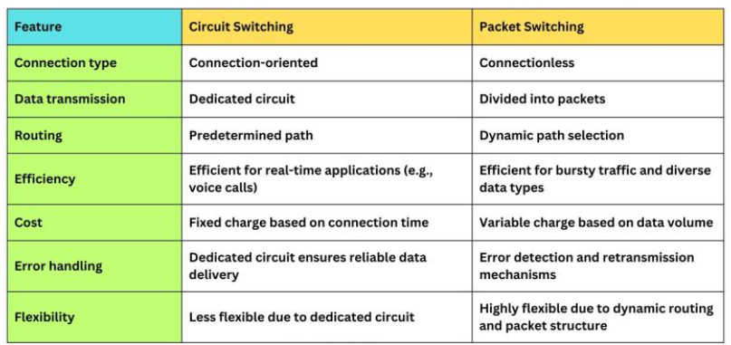
Comparison of Circuit Switch and Packet Switch

Slide 54
VIRTUAL-CIRCUIT NETWORKS
A virtual-circuit network is a cross between a circuit-switched network and a datagram network. It has some characteristics of both.
A virtual circuit network is a packet-switching technology that sets up a single, predefined path between a sender and a receiver before any data moves.
Although the data packets may travel through shared physical links, they all follow the same predefined route and arrive in the correct order
Characteristics
A connection is established before data transfer.
All packets follow the same path.
Packets arrive in sequence.
Each packet carries a Virtual Circuit Identifier (VCI).

Slide 55
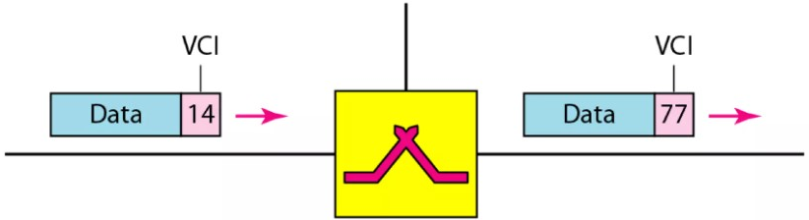
ADDRESSING
In a virtual circuit network, two types of addressing are involved: global and local (Virtual-circuit identifier)
Global Addressing A source or a destination address needs to have a global address-an address that can be unique in the scope of the network or internationally if the network is part of an international network.
Virtual-Circuit Identifier : The identifier that is actually used for data transfer is called the virtual-circuit identifier (VCI). A VCI is a small number that has only switch scope. It is used by a frame between two switches.

Slide 56
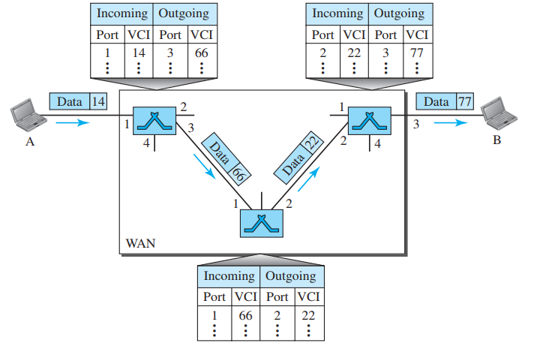
Virtual-Circuit Networks
As in a circuit-switched network, a source and destination need to go through three phases in a virtual-circuit network: setup, data transfer, and teardown.
Setup phase: the source and destination use their global addresses
Data-Transfer Phase: To transfer a frame from a source to its destination, all switches need to have a table entry for this virtual circuit. The table, in its simplest form, has four columns.

Slide 57
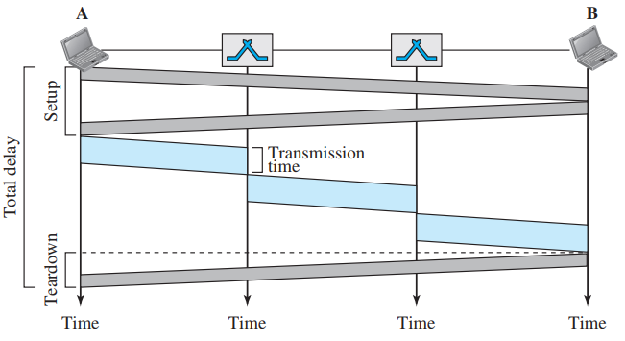
Virtual-Circuit Networks
Teardown Phase
Source A, after sending all frames to B, sends a special frame called a teardown request.
Destination B responds with a teardown confirmation frame.
All switches delete the corresponding entry from their tables.

